Slide 1
MAP583 - AGE ESTIMATION PROJECT
TEAM B2
Jie WANG Siyuan LIN
09/03/2021

Slide 2
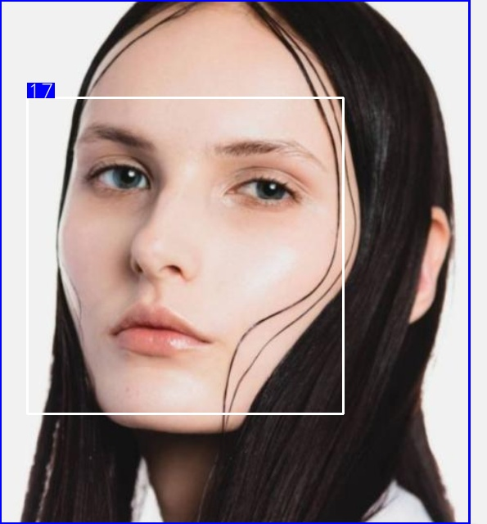
Age
Gender
Happiness
Race
Makeup
Time
….
APPA-REAL Dataset
Extended Dataset

Slide 3

Two options
Train multiple models (one for each task)
Inject all knowledge in a single model

Slide 4
CONTENTS
From original model to MTL model
Model updating
Loss function & Accuracy function
Comparison and Analysis of Results
Age only or Gender only
One based on another
Combination of two
Conclusion and further comments

Slide 5
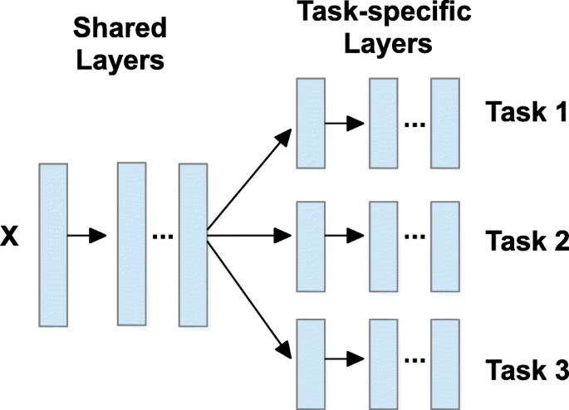
MULTI-TASK LEARNING

Slide 6
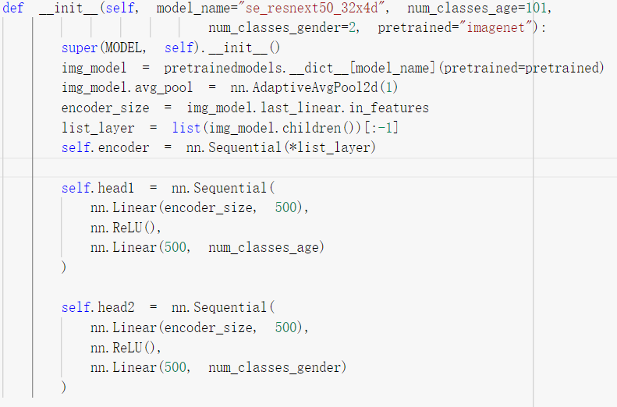
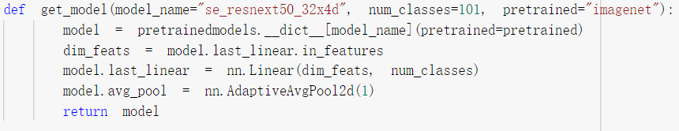
Model Updating
Original Model
Multi-Task Model

Slide 7
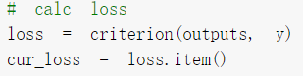
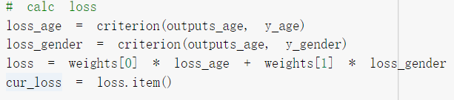
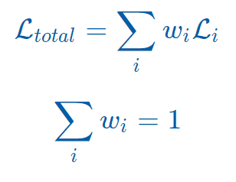
Loss function
Original Model
Multi-Task Model
Notes:
Each task has its own loss and the total loss is a weighted combination.
Handcrafted task weighting

Slide 8
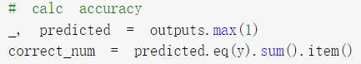
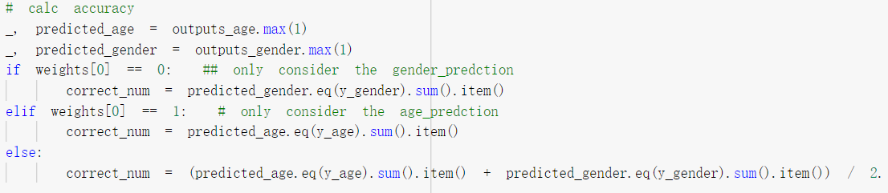
Accuracy function
Original Model
Multi-Task Model

Slide 9
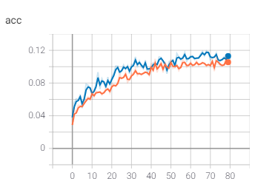
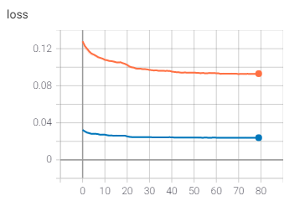
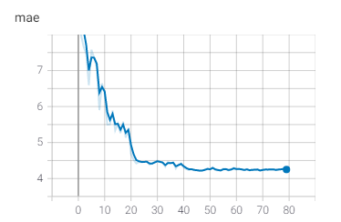
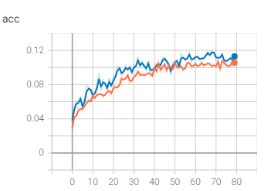
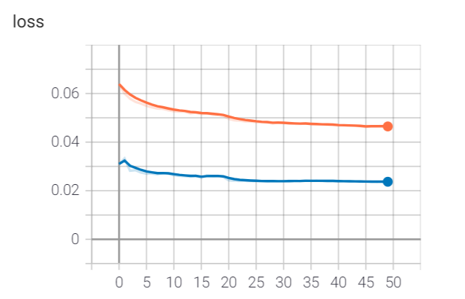
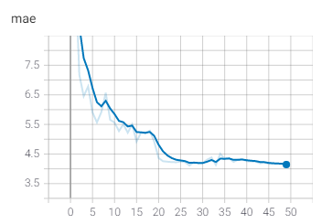
AGE only: weight = [1,0]
train
evaluate
Original model
Multi-task model
Equivalence?
Notes:
loss = loss_age because weight=[1,0]
loss_gender无意义
blue: loss_val 没变
orange: loss_train 减了一半

Slide 10
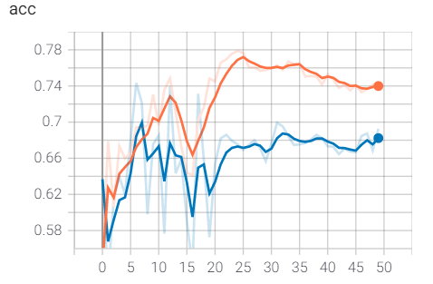
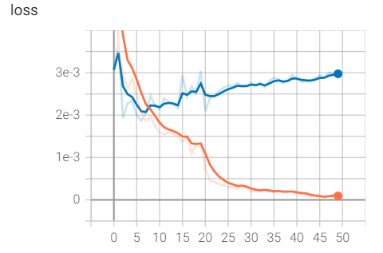
GENDER only: weight = [0,1]
acc(gender) ~ 70% >> acc(age) ~ 10%

Slide 11
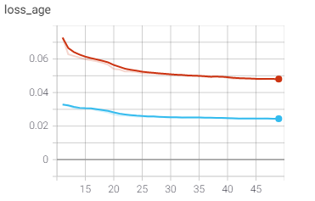
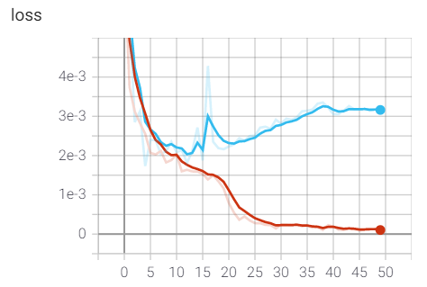
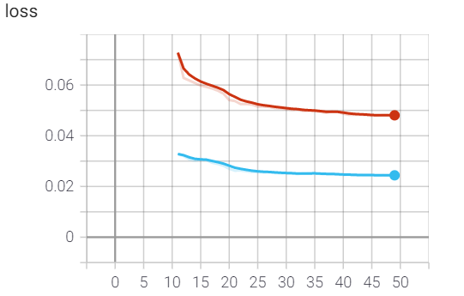
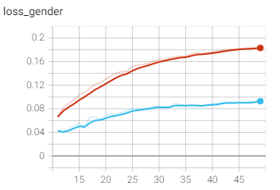
AGE Based on Gender
epoch 0-10 gender_only + epoch 11-50 age_only
gender_only
age_only
loss of gender only: weight =[0,1]
Notes:
if we train age based on gender, during the train: loss_age rises, but loss_genser falls

Slide 12
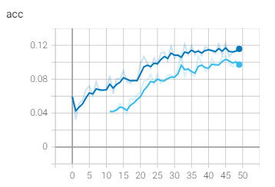
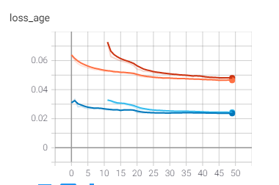
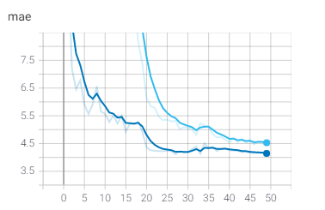
AGE Based on Gender
epoch 0-10 gender_only + epoch 11-50 age_only VS epoch 0-50 age_only
(1)
(2)
train (1)
train (2)
evaluate (1)
evaluate (2)

Slide 13
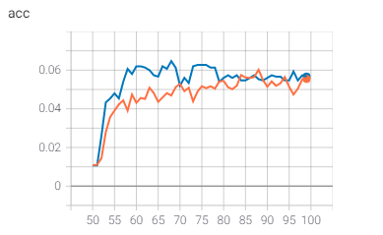
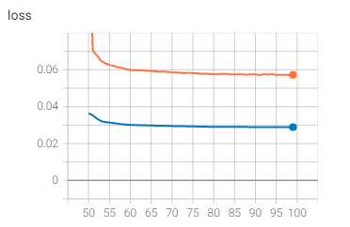
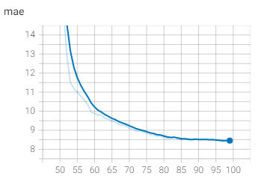
AGE Based on Gender
epoch 0-50 gender_only + epoch 51-100 age_only
< 0.1
> 4.5

Slide 14
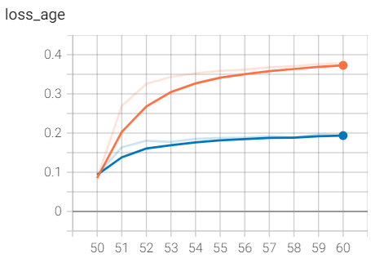
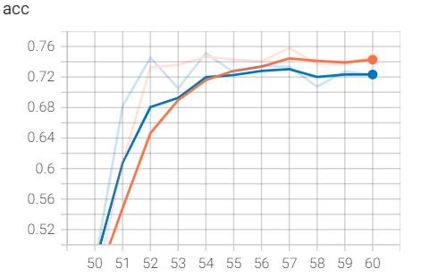
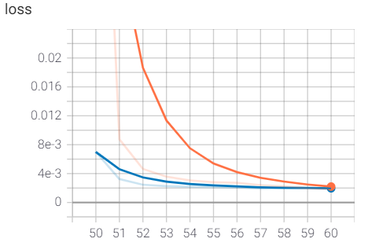
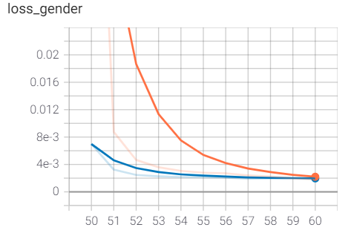
GENDER Based on Age
epoch 0-50 age_only + epoch 51-60 gender_only
> acc(gender_only) ~ 70%

Slide 15
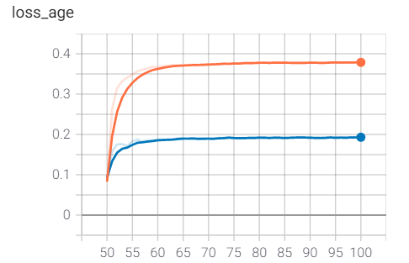
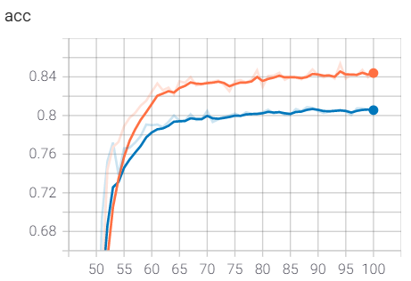
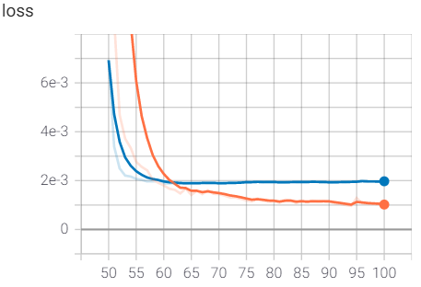
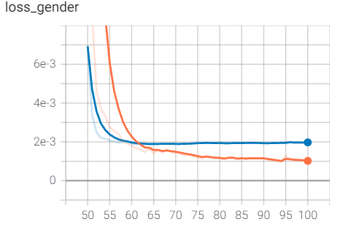
GENDER Based on Age
epoch 0-50 age_only + epoch 51-100 gender_only
> acc(gender_only) ~ 70%

Slide 16
AGE + GENDER: multi-task
loss of age only: weight =[1,0]
loss of gender only: weight =[0,1]
10 times larger

Slide 17
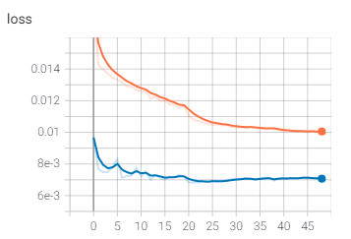
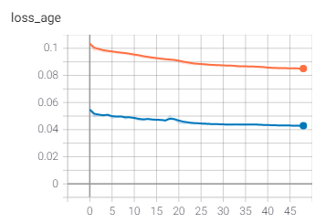
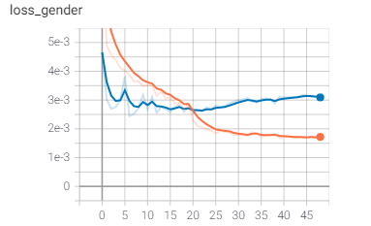
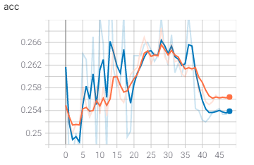
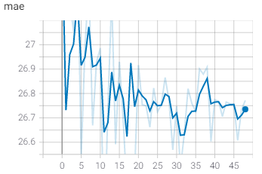
AGE + GENDER: weight = [0.1,0.9]
>> mae(age_only) ~ 4.5

Slide 18
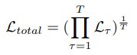
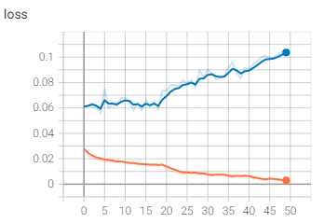
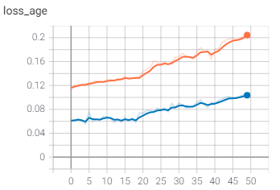
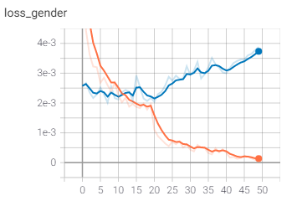
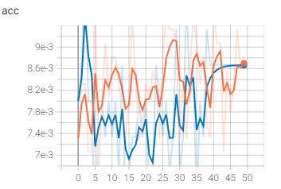
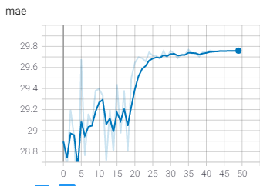
AGE + GENDER: Geometric loss
loss = (loss_age * loss_gender) ^ (1/2)
>> mae(age_only) ~ 4.5

Slide 19
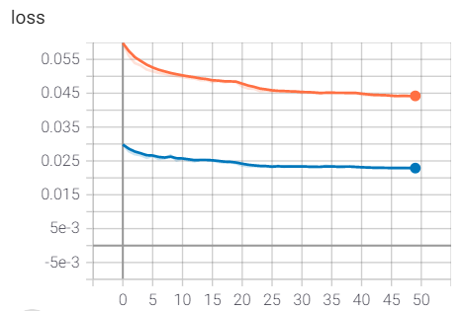
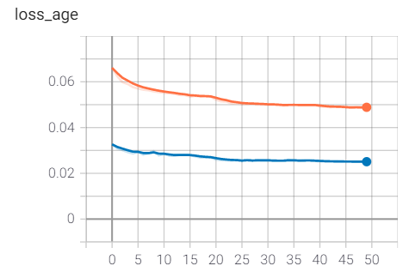
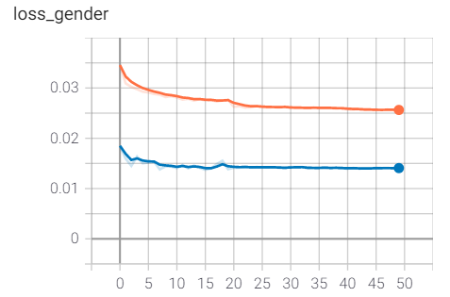
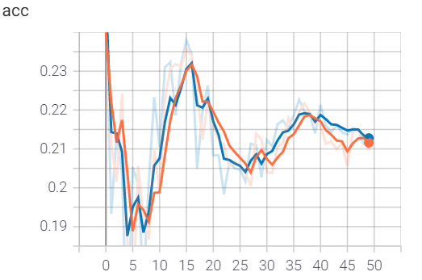

AGE + GENDER: weight = [0.8,0.2]
acc >> acc(age_only) ~0.10
mae ≈ mae(age_only) ~ 4.5

Slide 20





Slide 21





Slide 22
CONCLUSION
Highly practical method
Shared encoder can be shared among many tasks
Idea of transfer learning not efficient when estimating age
Improved accuracy when estimating gender
Optimal MTL model when weights = [0.8,0.2]

Slide 23
What can be improved?
Choice of methods of calculating loss function
e.g. Dynamic task loss scaling, Geometric loss…
Choice of weights; balancing difficulties
e.g. Weight learning
More tasks per network
e.g. Race, Make-up, Expression….

